Slide 1
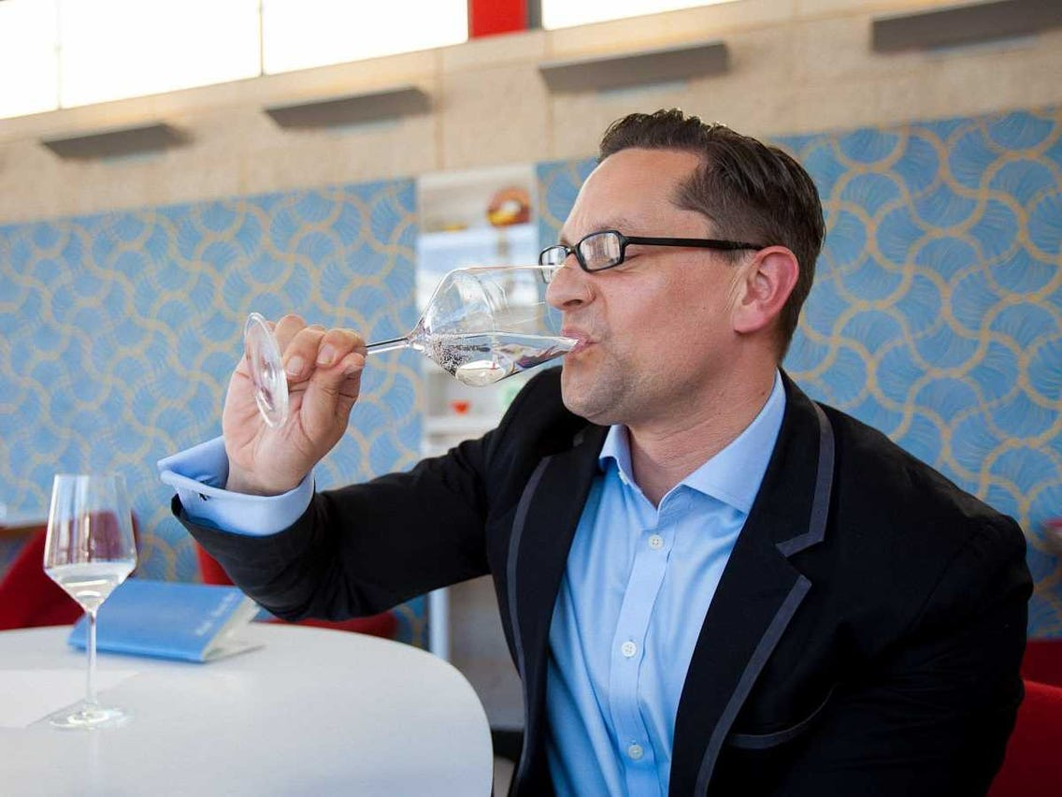
Intelligent Seasoner
© Business Insider
Term Project
Midterm Progress Report
110-1 Embedded System Labs
Advisor: 王勝德 教授
Members: 莊立楷、戴偉翔、闕嘉宏
2021/12/17

Slide 2
Outline
How it works? (Flow)
Challenges

Slide 3
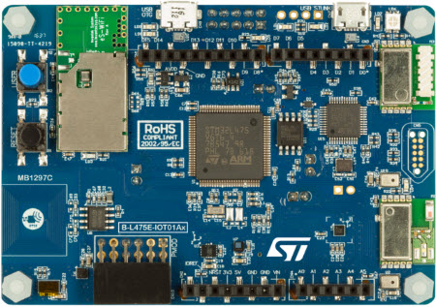
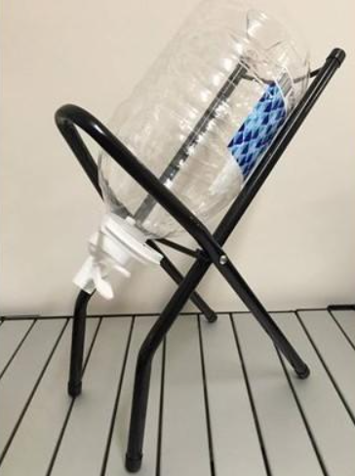
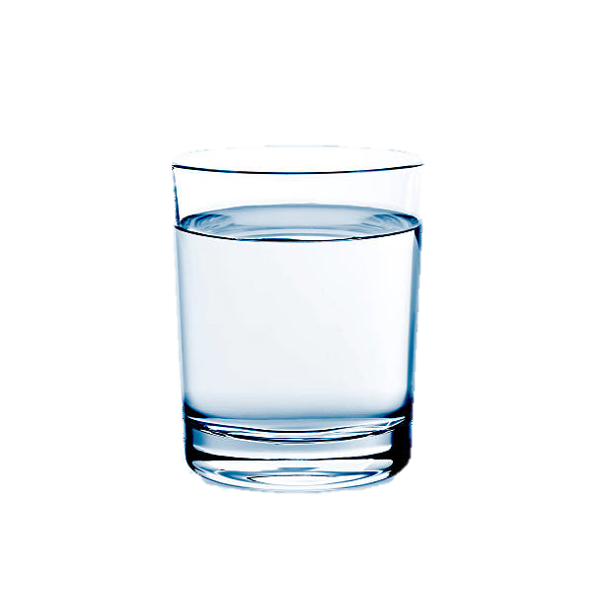
Flow
Analog Signal of TDS Value
Servo Motor
TDS meter
Servo Motor
Servo Motor
Stirring rod
Pure
Water
Mineral Water

Slide 4
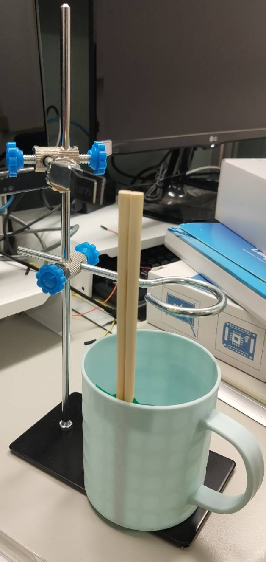
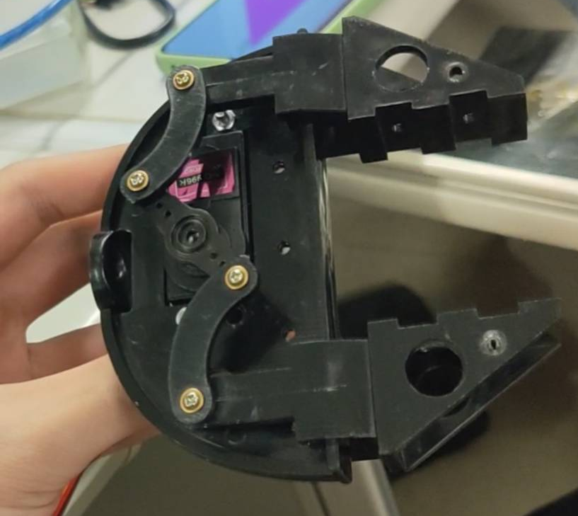
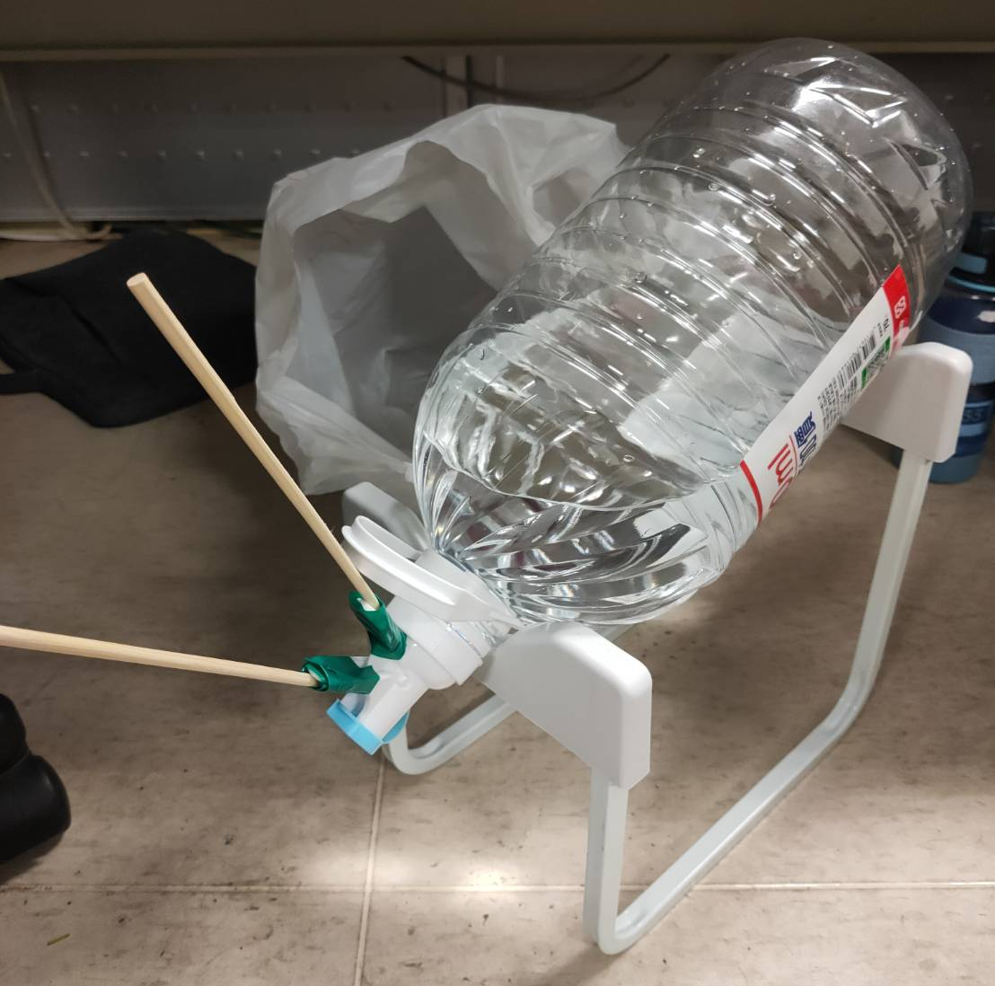
Current Progress
Mainly focus on:
Mechanism
Sensor Stability Testing
Research on the mineral water from different brands

Slide 5
Challenges
The control of the servo motor by STM32 is not stable and usable now.
Temporary solution: We use Arduino as the alternation.
The flow of water may be affected by the quantity of water remained in the bottle.
Current servo motor doesn’t have enough torque to open the water dispenser valve.

Slide 6
Thank You

